Slide 1
Roadway Repairs and Maintenance
How does CEC go about it?
Alastair Webb, MCC Chair – Sept 25, 2025
chair@morningside.org.uk

Slide 2
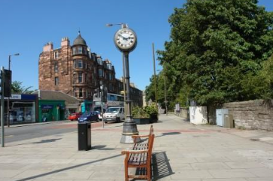
Who Am I?
Chair MCC since elections in Spring
Retired, IT consultancy background, lived in Edinburgh since 1997
Learning on the job: this topic is a case in point ( I'm hoping to learn tonight !)
As well as learning, I hope this 30 minutes:
  Explains a bit about how CEC 'discovers', assesses, prioritises, schedules, delivers roadway maintenance and repairs
  Suggests how the public / CCs could 'add' (beneficially) to the 'process', so aiding CEC
  And how we could be better kept within the 'loop' / timeline to completion / fixing the problem; improving satisfaction with the CEC's efforts

Slide 3
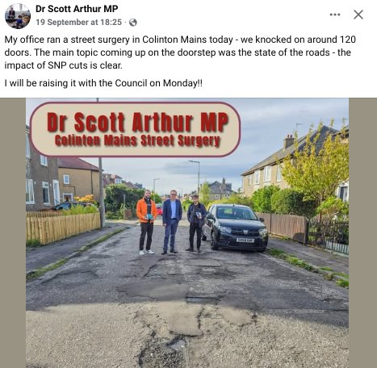
Why Roads & Pavements?
Firstly, engage our community with relevant issues
MCC has a good reputation for being a space to talk about local issues, and we get reasonable attendances (circa 10-20 non members per meeting), but we are told many folk are unaware of the CC
And roads/pavements generate lots of discussion, with frustration & puzzlement
This is very evident online, but also we are told it's one of the most common topics in councilors mailbags
Recent post from Dr Scott Arthur MP reinforces this
And it's one of the council services that affects us all
So , by working with councilors & officers, can we:
Help the community understand council processes
Reduce frustration through clarity
Provide local knowledge to support prioritisation
NB: Focus on the 'came up on doorsteps bit'...other political parties differ in their 'root cause' analysis !

Slide 4
Progress So Far
Focus has been on maintenance /repair of roads & pavements:
Simpler than multiple enhancement schemes
Indebted to Cliff Hutt (Head of Roads & Infrastrucfure) to understand processes
And Cliff & his colleague Sean Gilchrist (Transport Manager – Head of Assets & Performance) did a v helpful presentation to MCC last week
Understanding how to improve pavements & roads looks to be more complex, with a wider range of programmes in the council that do this... so parked for now (Note: am v interested in Merchiston CC presentation !)

Slide 5
Maintenance Workflow
Inspection / Reporting:
Potholes
Scottish Road Condition Survey
Walking
Planning / Design / Prioritisation & allocation to budget:
Small revenue
Large Revenue
Capital
Build
Current sources of public info
Described in more detail in notes at end
Pothole Map & emails
Capital Infrastructure report presented to TEC in April
Roadworksscotland map

Slide 6
Opportunities – Information Flow
Cllr Ross has recently had a motion passed asking for officers to consider how to improve reporting, so that could be things like:
  Publishing a road-map showing results of Scottish Road Surveys results
  Providing a draft version of Capital Programme in preceding Autumn
  Publish the capital programme in a .CSV format, so easily searched by ward / roadname
  Maintaining a list of candidates for improvements that didn't quite make the prioritisation
  Marking 'pothole' map with priority assessment of hole (this has a known issue)
  Maintaining / publishing the Large & Small Revenue programmes
  When Roadworks being done, add a note to RoadworksScotland website to explain 'why' work being done
But also more general information
  Presentation (will be on our website) from Cliff & Sean was really good & well received, but really reaches about 30 people – how could that be scaled ? and how can officers get consolidated feedback (eg residual gravel from surface treatments is a regular complaint)
HELP --- Any thoughts on this, usefullness, other data options, etc, please email

Slide 7
Opportunities – Influencing Work
Can we find a way for folk (possibly via CC) to feed in questions / requests to 'a process' rather than relying on Councillors sending individual emails ?
For the Scottish Roads Survey, all roads checked every 4 years (approx), but its quite possible that a road deteriorates between inspections; could CC's submit a list of candidate roads to supplement survey ? And if road not selected some sort of summary as to 'why not' ?
HELP --- Any thoughts on this, do we want CC's to have a more formal roles in process, etc please email

Slide 8
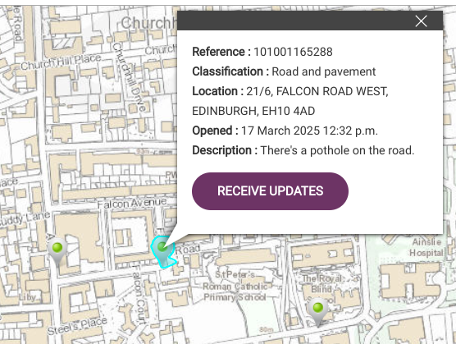
Notes & references - 1
Public Pothole Reporting
https://webforms.edinburgh.gov.uk/site/portal/request/road_defect
Reporting tool opens a map where existing reports are visible
Geared to reporting 1 specific problem, not an area of 'generally poor surface'
Covers both potholes and pavement defects
Raisers get an email acknowleging it (& you can request updates for others you see on map)

Slide 9
Notes & references - 2
Scottish Roads Conditions Survey
https://www.scotsnet.org.uk/programmes/road-condition-surveys
Reports held on central database, councils given access, not available to public
Based on doing a sample of roads; our local roads are all unclassified, so Scotsnet says 10% surveyed, but Edinburgh says has 25% done each year
Generates an index ranking that is a KPI for council

Slide 10
Notes & references - 3
Capital Works Infrastructure Programme
Prioritised list generated in Autumn
Consists of preventative maintenance (carriageway resurfacing, pavement slutty sealing), which aims to prolong useful life of road at low cost
And more expensive/extensive 'road repairs'
Published at TEC in spring in PDF - https://democracy.edinburgh.gov.uk/documents/s82577/8.1%20-%20Roads%20and%20Infrastructure%20Investment%20-%20Capital%20Delivery%20Priorities%202025_26.pdf

Slide 11
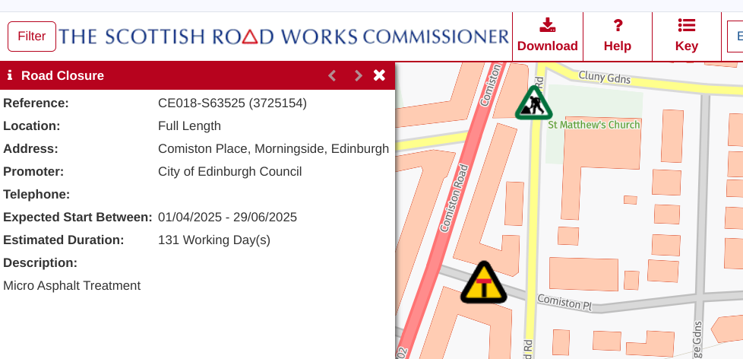
Notes & references - 4
Roads Commissioners’ Roadworks Register
Maintains list of all planned roadworks, including:
  Revenue & Capital Infra Repairs
  Utility work
  Improvement programmes
https://www.roadworksscotland.org
Has useful map showing data: eg

