Slide 1
Active travel –
What this means for Community Councils
Edinburgh Association of Community Councils
26 March 2026
Mike Birch – New Town and Broughton Community Council

Slide 2
Active Travel – What this means for Community Councils
What is Active Travel?
How does this fit into the City Mobility Plan?
Why is this important for Community Councils?
What are challenges for Community Councils?
What are opportunities for Community Councils?
Recent examples of work by New Town and Broughton Community Council
Discussion

Slide 3
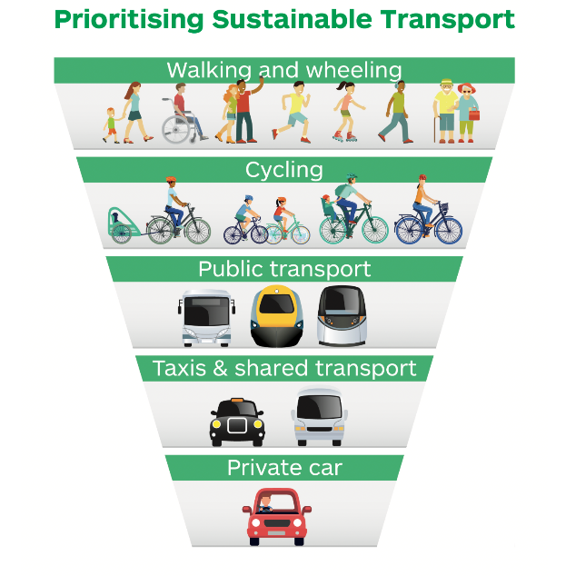
What is Active Travel?
Active travel is defined by Transport Scotland as being:
  Walking, wheeling, or cycling for a purposeful journey, such as commuting, accessing education, or visiting shops
Travel Hierarchy sets out the relative priority of the different means of travel
Combining Cycling and Walking/Wheeling together under heading of Active Travel creates issues where the needs of these groups are not aligned.

Slide 4
How does this fit within the City Mobility Plan?
Active Travel is a key element of the City Mobility Plan through Delivering Actions for Active Travel (Feb 2024)
City Mobility Plan has 6 separate actions under Active Travel including to deliver dropped kerbs, improved pavements, reduced pavement clutter and more rest spots.
Active Travel Improvement Programme Update posted on Council website in January 2026
Update shows 60 projects of which 11 have been completed and 9 are currently in progress.

Slide 5
Why is this important for Community Councils?
Active travel is key element in Council’s goals to reduce car usage and create 20-minute neighbourhoods
Significant expenditure each year across the city - need to ensure local priorities are clear
Walkable neighbourhoods one of the highest priorities for community

Slide 6
What are challenges for Community Councils?
Community Councils have no special status with respect to active travel schemes or Traffic Regulation Orders
Limited information available to Community Councils or public on planned projects
Competing pressures from different active travel groups may not align with the needs of local community

Slide 7
What are opportunities for Community Councils?
Active travel projects are part of City Mobility Plan updates - opportunity to influence Transport and Environment Committee decisions
Design of active travel projects - need to provide input based on local knowledge
Active travel groups can have useful input on proposals - seek engagement/support
Many active travel projects require Traffic Regulation Orders to be approved – statutory opportunity to comment on changes
Local Traffic Improvement Programme applications – identify small projects which can enhance active travel and road safety
Transport and Local Access Forum - two Community Councils added to the membership of Forum in January 2026

Slide 8
Examples of recent NTBCC Active Travel engagement
St Mark’s Path Closure – lobbied for path to be reopened
Rose Street Contra-Flow Cycling - objected to this street being included in Council plans
Trams to Newhaven - highlighted need for improvements to tactile paving installation.
Local Traffic Improvement Programme – submitted several applications for local projects
George Street Redevelopment - issued deputation seeking inclusion of cross streets in project
Pavement Width Guidance - lobbied for clarity on application of ESDG
Experimental Traffic Orders - objected to making orders permanent without improvements to infrastructure

Slide 9
Active Travel – Discussion
Questions and Discussion

